Slide 1
Loco Motives
From a puzzle by Chris Maslanka (The Guardian)

Slide 2



Loco Motives
(not drawn to scale)
$$9$$
$$9$$
$$4$$
$$4$$
In each diagram there are two identical circles and a smaller one fitting snugly into a rectangle.
Their radii are as shown in the diagrams. All measurement are in cm.
What is the difference in the widths of the rectangles?

Slide 3


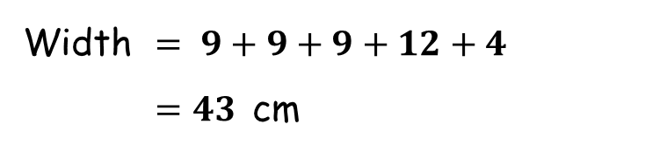





Loco Motives
(not drawn to scale)
$$13$$
$$9$$
$$5$$
$$9$$
$$12$$
$$4$$
$$4$$
Width $= 9+9+9+12+4$
$=43$ cm
Width $= 9+12+12+9$
$=42$ cm
The difference in widths is $1$ cm
Why is the answer the same on all of your worksheets?

Slide 4
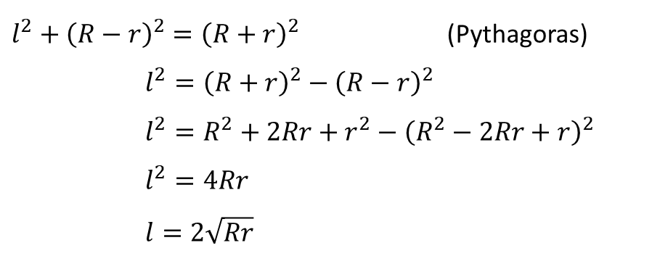





Loco Motives
Let the radii be $R$ and $r$ and develop an expression for the difference in width.
$l^{2}+{\left(R−r\right)}^{2}={\left(R+r\right)}^{2}$ (Pythagoras)
$l^{2}={\left(R+r\right)}^{2}−{\left(R−r\right)}^{2}$
$l^{2}=R^{2}+2Rr+r^{2}−{\left(R^{2}−2Rr+r\right)}^{2}$
$l^{2}=4Rr$
$l=2\sqrt{Rr}$
$$R+r$$
$$R−r$$
$$R$$
$$l$$
$$r$$

Slide 5
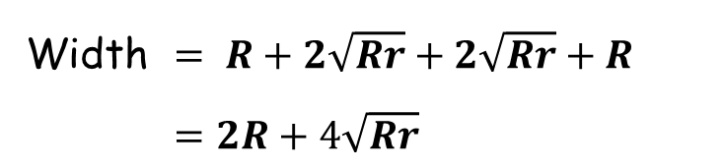








Loco Motives
$$R$$
$$2\sqrt{Rr}$$
$$R$$
$$2\sqrt{Rr}$$
$$r$$
$$r$$
Width $=R+R+R+2\sqrt{Rr}+r$
$=3R+r+2\sqrt{Rr}$
Width $= R+2\sqrt{Rr}+2\sqrt{Rr}+R$
$=2R+4\sqrt{Rr}$
The difference in widths is $R+r−2\sqrt{Rr}$ cm.
Can you spot a relationship between the values of the radii on your worksheets?

Slide 6
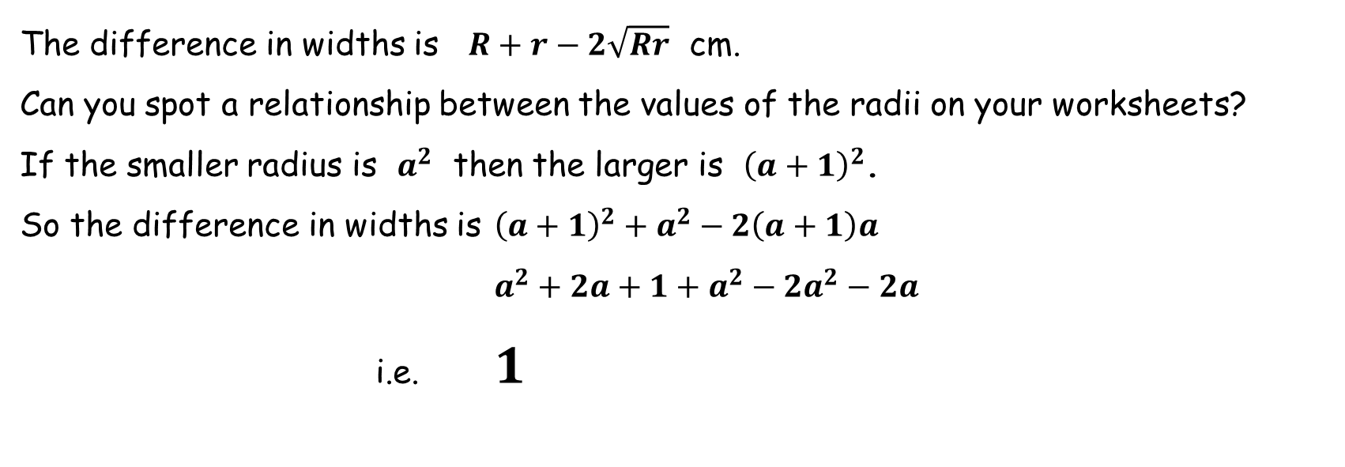
Loco Motives
The difference in widths is $R+r−2\sqrt{Rr}$ cm.
Can you spot a relationship between the values of the radii on your worksheets?
If the smaller radius is $a^{2}$ then the larger is ${\left(a+1\right)}^{2}$.
So the difference in widths is ${\left(a+1\right)}^{2}+a^{2}−2\left(a+1\right)a$
$a^{2}+2a+1+a^{2}−2a^{2}−2a$
i.e. $1$

Slide 7
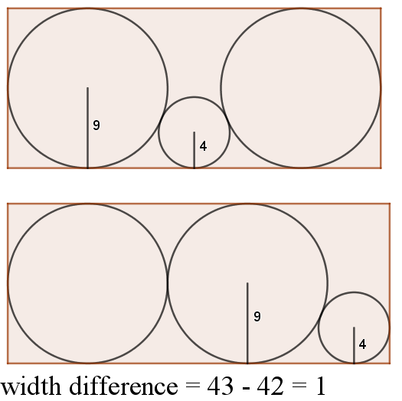
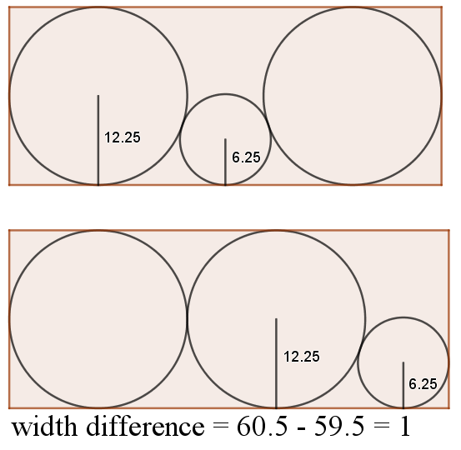
Some examples from the worksheets:

Slide 8
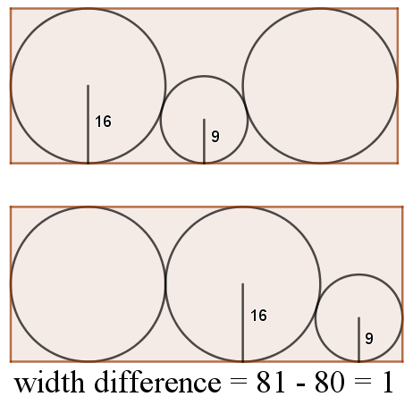
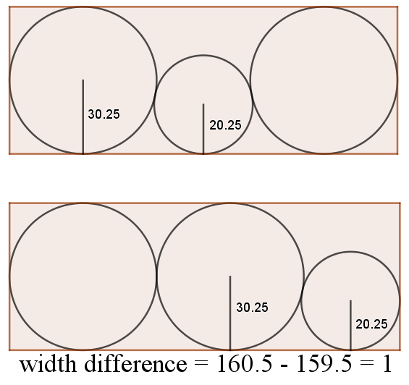
Some examples from the worksheets:

Slide 9
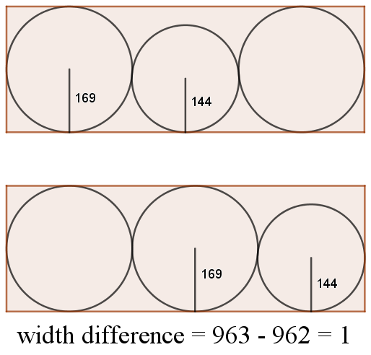
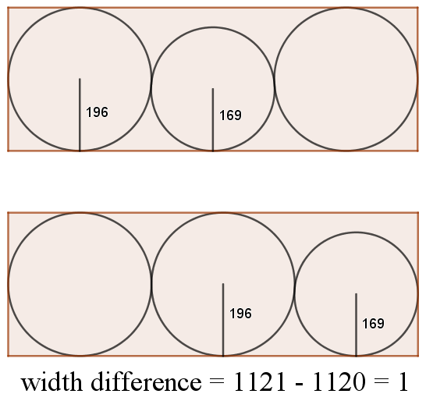
Some examples from the worksheets:

Slide 11
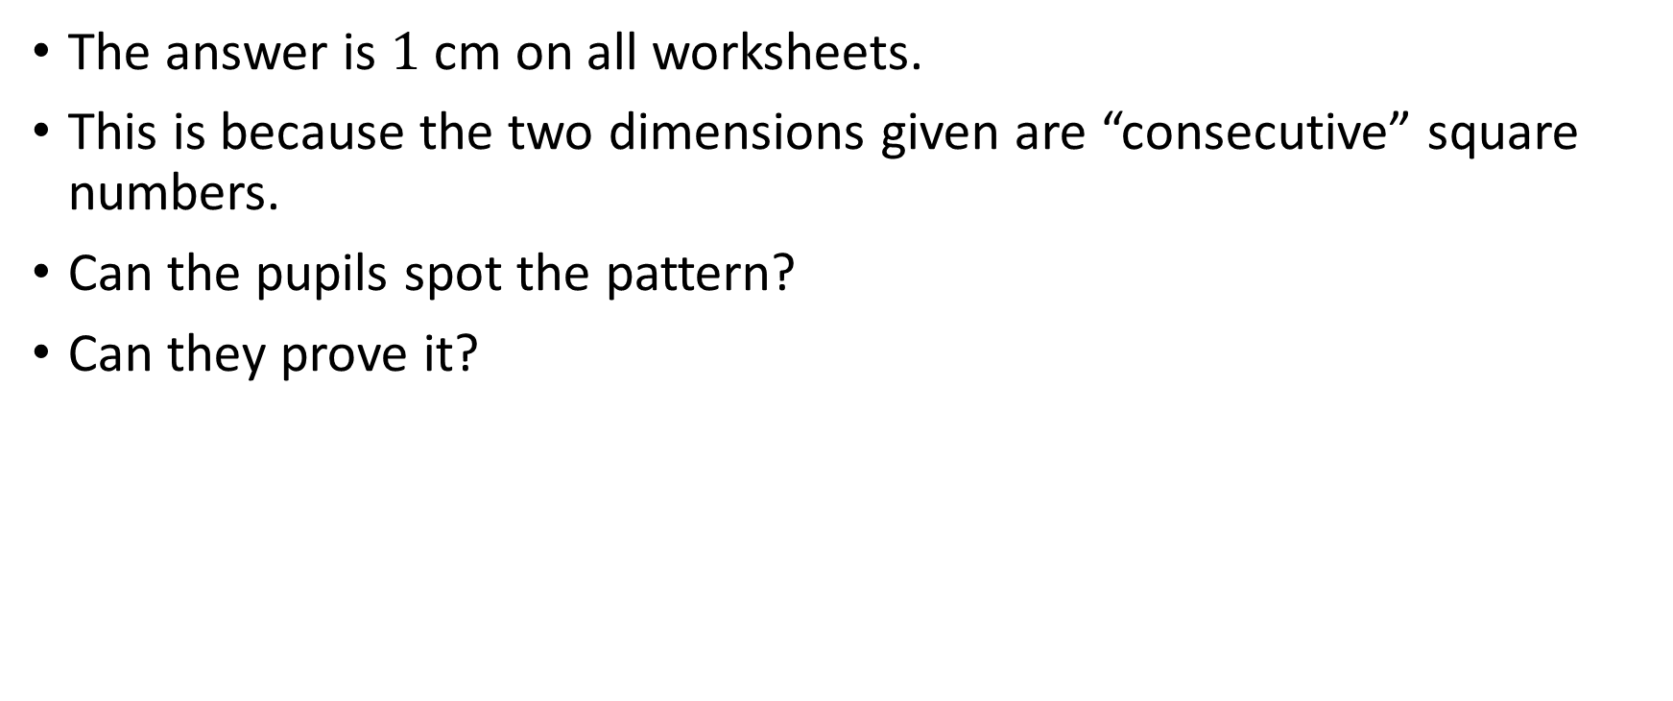
Teacher Notes
The answer is $1$ cm on all worksheets.
This is because the two dimensions given are “consecutive” square numbers.
Can the pupils spot the pattern?
Can they prove it?

Slide 12
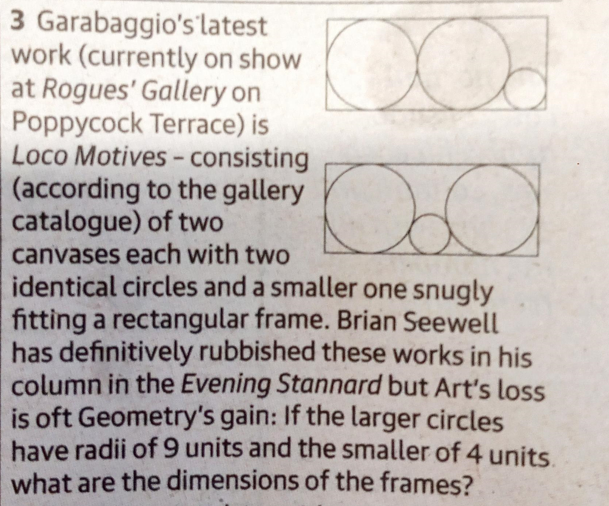
The Guardian

Slide 13
Resources

Slide 14



Loco Motives
(not drawn to scale)
$$9$$
$$9$$
$4$
$4$
In each diagram there are two identical circles and a smaller one fitting snugly into a rectangle.
Their radii are as shown in the diagrams. All measurement are in cm.
What is the difference in the widths of the rectangles?
SIC_90

Slide 15




Loco Motives
(not drawn to scale)
$$6.25$$
$$6.25$$
$$2.25$$
$$2.25$$
In each diagram there are two identical circles and a smaller one fitting snugly into a rectangle.
Their radii are as shown in the diagrams. All measurement are in cm.
What is the difference in the widths of the rectangles?
SIC_90

Slide 16




Loco Motives
(not drawn to scale)
$$4$$
$$4$$
$1$
$1$
In each diagram there are two identical circles and a smaller one fitting snugly into a rectangle.
Their radii are as shown in the diagrams. All measurement are in cm.
What is the difference in the widths of the rectangles?
SIC_90

Slide 17




Loco Motives
(not drawn to scale)
$$12.25$$
$$12.25$$
$6.25$
$6.25$
In each diagram there are two identical circles and a smaller one fitting snugly into a rectangle.
Their radii are as shown in the diagrams. All measurement are in cm.
What is the difference in the widths of the rectangles?
SIC_90

Slide 18




Loco Motives
(not drawn to scale)
$$20.25$$
$$20.25$$
$12.25$
$12.25$
In each diagram there are two identical circles and a smaller one fitting snugly into a rectangle.
Their radii are as shown in the diagrams. All measurement are in cm.
What is the difference in the widths of the rectangles?
SIC_90

Slide 19




Loco Motives
(not drawn to scale)
$$16$$
$$16$$
$9$
$9$
In each diagram there are two identical circles and a smaller one fitting snugly into a rectangle.
Their radii are as shown in the diagrams. All measurement are in cm.
What is the difference in the widths of the rectangles?
SIC_90

Slide 20




Loco Motives
(not drawn to scale)
$$25$$
$$25$$
$16$
$16$
In each diagram there are two identical circles and a smaller one fitting snugly into a rectangle.
Their radii are as shown in the diagrams. All measurement are in cm.
What is the difference in the widths of the rectangles?
SIC_90

Slide 21




Loco Motives
(not drawn to scale)
$$30.25$$
$$30.25$$
$20.25$
$10.25$
In each diagram there are two identical circles and a smaller one fitting snugly into a rectangle.
Their radii are as shown in the diagrams. All measurement are in cm.
What is the difference in the widths of the rectangles?
SIC_90

Slide 22




Loco Motives
(not drawn to scale)
$$36$$
$$36$$
$25$
$25$
In each diagram there are two identical circles and a smaller one fitting snugly into a rectangle.
Their radii are as shown in the diagrams. All measurement are in cm.
What is the difference in the widths of the rectangles?
SIC_90

Slide 23




Loco Motives
(not drawn to scale)
$$42.25$$
$$42.25$$
$30.25$
$30.25$
In each diagram there are two identical circles and a smaller one fitting snugly into a rectangle.
Their radii are as shown in the diagrams. All measurement are in cm.
What is the difference in the widths of the rectangles?
SIC_90

Slide 24




Loco Motives
(not drawn to scale)
$$49$$
$$49$$
$36$
$36$
In each diagram there are two identical circles and a smaller one fitting snugly into a rectangle.
Their radii are as shown in the diagrams. All measurement are in cm.
What is the difference in the widths of the rectangles?
SIC_90

Slide 25




Loco Motives
(not drawn to scale)
$$56.25$$
$$56.25$$
$42.25$
$42.25$
In each diagram there are two identical circles and a smaller one fitting snugly into a rectangle.
Their radii are as shown in the diagrams. All measurement are in cm.
What is the difference in the widths of the rectangles?
SIC_90

Slide 26




Loco Motives
(not drawn to scale)
$$64$$
$$64$$
$49$
$49$
In each diagram there are two identical circles and a smaller one fitting snugly into a rectangle.
Their radii are as shown in the diagrams. All measurement are in cm.
What is the difference in the widths of the rectangles?
SIC_90

Slide 27




Loco Motives
(not drawn to scale)
$$75.25$$
$$75.25$$
$56.25$
$56.25$
In each diagram there are two identical circles and a smaller one fitting snugly into a rectangle.
Their radii are as shown in the diagrams. All measurement are in cm.
What is the difference in the widths of the rectangles?
SIC_90

Slide 28




Loco Motives
(not drawn to scale)
$$81$$
$$81$$
$64$
$64$
In each diagram there are two identical circles and a smaller one fitting snugly into a rectangle.
Their radii are as shown in the diagrams. All measurement are in cm.
What is the difference in the widths of the rectangles?
SIC_90

Slide 29




Loco Motives
(not drawn to scale)
$$90.25$$
$$90.25$$
$72.25$
$72.25$
In each diagram there are two identical circles and a smaller one fitting snugly into a rectangle.
Their radii are as shown in the diagrams. All measurement are in cm.
What is the difference in the widths of the rectangles?
SIC_90

Slide 30




Loco Motives
(not drawn to scale)
$$100$$
$$100$$
$81$
$81$
In each diagram there are two identical circles and a smaller one fitting snugly into a rectangle.
Their radii are as shown in the diagrams. All measurement are in cm.
What is the difference in the widths of the rectangles?
SIC_90

Slide 31




Loco Motives
(not drawn to scale)
$$110.25$$
$$110.25$$
$90.25$
$90.25$
In each diagram there are two identical circles and a smaller one fitting snugly into a rectangle.
Their radii are as shown in the diagrams. All measurement are in cm.
What is the difference in the widths of the rectangles?
SIC_90

Slide 32




Loco Motives
(not drawn to scale)
$$121$$
$$121$$
$100$
$100$
In each diagram there are two identical circles and a smaller one fitting snugly into a rectangle.
Their radii are as shown in the diagrams. All measurement are in cm.
What is the difference in the widths of the rectangles?
SIC_90

Slide 33




Loco Motives
(not drawn to scale)
$$132.25$$
$$132.25$$
$110.25$
$110.25$
In each diagram there are two identical circles and a smaller one fitting snugly into a rectangle.
Their radii are as shown in the diagrams. All measurement are in cm.
What is the difference in the widths of the rectangles?
SIC_90

Slide 34




Loco Motives
(not drawn to scale)
$$144$$
$$144$$
$121$
$121$
In each diagram there are two identical circles and a smaller one fitting snugly into a rectangle.
Their radii are as shown in the diagrams. All measurement are in cm.
What is the difference in the widths of the rectangles?
SIC_90

Slide 35




Loco Motives
(not drawn to scale)
$$156.25$$
$$156.25$$
$132.25$
$132.25$
In each diagram there are two identical circles and a smaller one fitting snugly into a rectangle.
Their radii are as shown in the diagrams. All measurement are in cm.
What is the difference in the widths of the rectangles?
SIC_90

Slide 36




Loco Motives
(not drawn to scale)
$$169$$
$$169$$
$144$
$144$
In each diagram there are two identical circles and a smaller one fitting snugly into a rectangle.
Their radii are as shown in the diagrams. All measurement are in cm.
What is the difference in the widths of the rectangles?
SIC_90

Slide 37




Loco Motives
(not drawn to scale)
$$196$$
$$196$$
$169$
$169$
In each diagram there are two identical circles and a smaller one fitting snugly into a rectangle.
Their radii are as shown in the diagrams. All measurement are in cm.
What is the difference in the widths of the rectangles?
SIC_90

